Slide 1
Deep Learning for Natural Language Processing
Dr. Minlie Huang (黄民烈)
aihuang@tsinghua.edu.cn
Computer Science Department
Tsinghua University
Homepage: http://aihuang.org/p

Slide 2
Outline
Background
Word Vectors
Recursive Neural Network
Recurrent Neural Network
Convolution Neural Network

Slide 3
Natural Language Processing
Natural language processing (NLP) is a field of computer science, artificial intelligence and computational linguistics concerned with the interactions between computers and human (natural) languages, and, in particular, concerned with programming computers to fruitfully process large natural language corpora.
Involve natural language understanding, natural language generation (frequently from formal, machine-readable logical forms), connecting language and machine perception, managing human-computer dialog systems, or some combination thereof.
From https://en.wikipedia.org/wiki/Natural_language_processing

Slide 4
Background: Natural Language Processing
Tagging and parsing
Question answering and dialogue systems
Text/document classification
Sentiment analysis and opinion mining
Machine translation

Slide 5
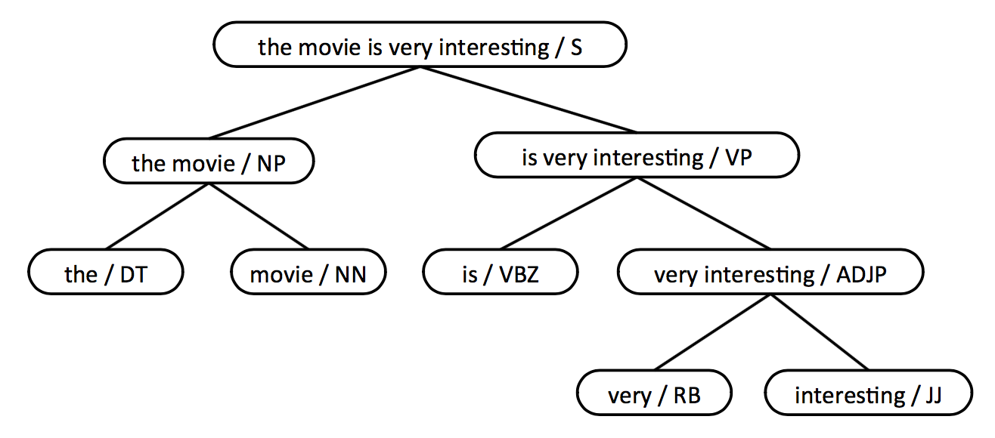
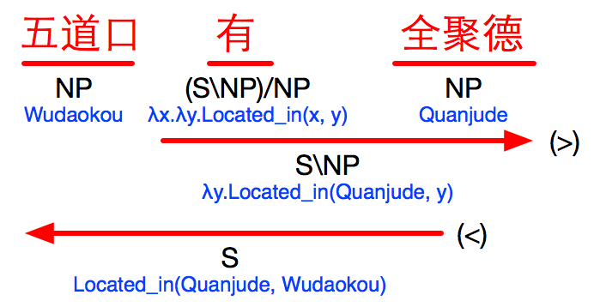
Tagging and Parsing
Part-of-speech
Tagging
The movie is very interesting
DT NN VBZ RB JJ
Semantic Parsing
Syntactic Parsing

Slide 6
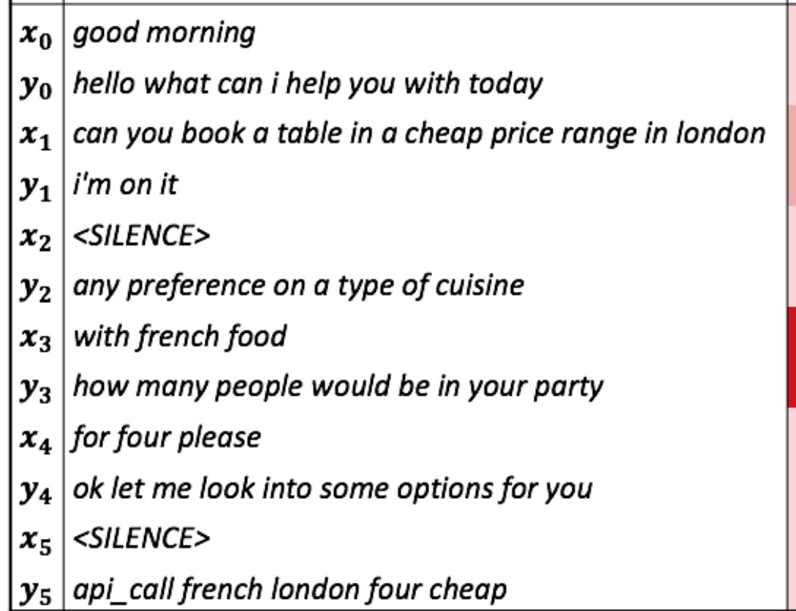
Question Answering and Dialogue Systems
Q: How many people live in Beijing?
A: About 22 million.
Q: How long is the Great Wall?
A: About 8800 km.
Q: What creates a cloud
A: in meteorology , a cloud is a visible mass of liquid droplets or frozen crystals made of water or various chemicals suspended in the atmosphere above the surface of a planetary body.

Slide 7
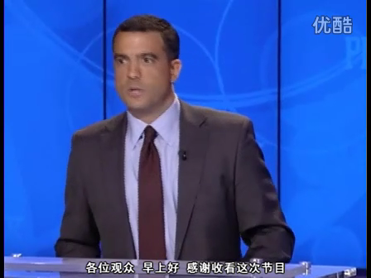
IBM DeepQA: Understanding Human Languages

Slide 8
Sentiment Analysis and Opinion Mining
Sentiment analysis (SA) or opinion mining
computational study of opinion, sentiment, appraisal, evaluation, and emotion.
Sentiment: an attitude, thought, or judgment prompted by feeling.
A sentiment is more of a feeling.
“I am concerned about the current state of the economy.”
Opinion: a view, judgment, or appraisal formed in the mind about a particular matter.
a concrete view of a person about something.
“I think the economy is not doing well.”
Slides from Prof. Bing Liu

Slide 9


Sentiment Analysis and Opinion Mining
Sentiment analysis (SA) or opinion mining
computational study of opinion, sentiment, appraisal, evaluation, and emotion.
Staff
Staffs are not that friendly, but the taste covers all.”
Taste

Slide 10
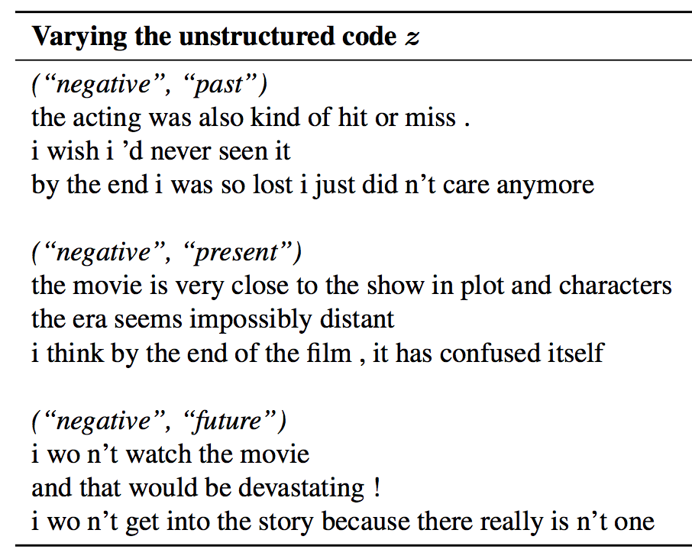
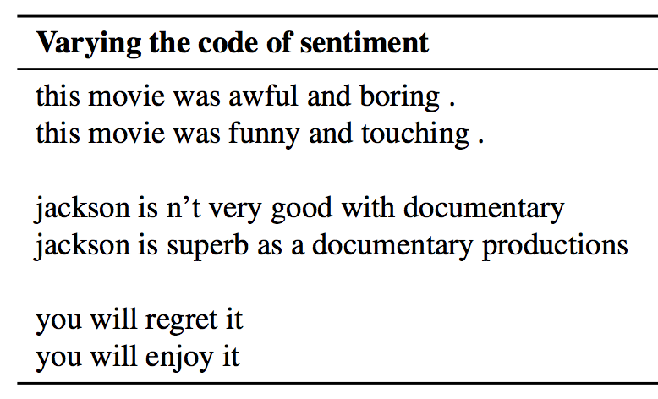
Emotion/Sentiment Generation
Hu Z, Yang Z, Liang X, et al. Controllable Text Generation[J]. arXiv preprint arXiv:1703.00955, 2017.
Notes:
时态：past tense; present tense;

Slide 11



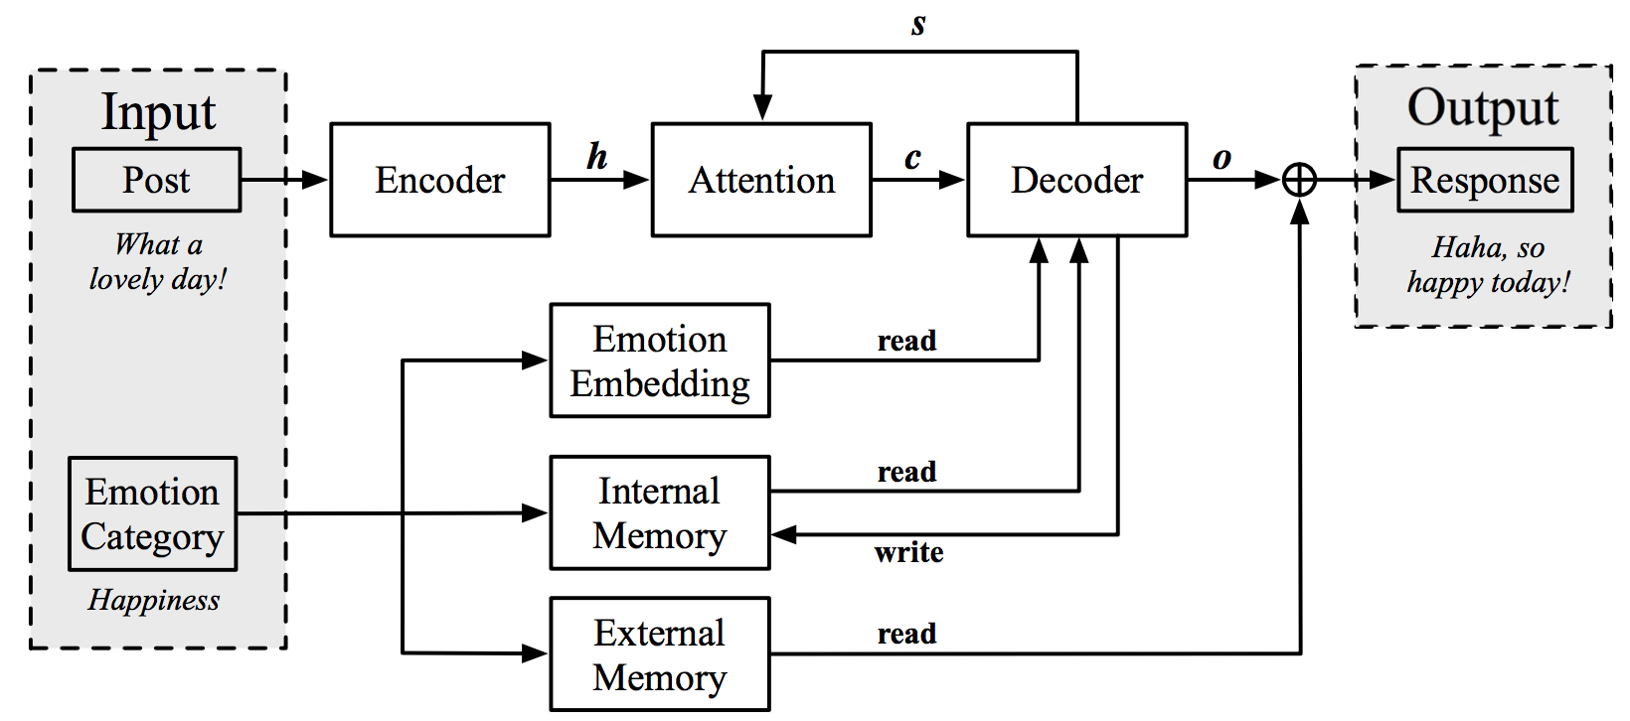
Emotional Content Generation
I am happy to hear about it.
How can you do that?!
I am so sad today.
POST
RESPONSE
POST
RESPONSE
EMOTIONAL CHATTING
MACHINE
EMOTION CLASSIFIER
POST
RESPONSE
POST
RESPONSE
…
HAPPY
ANGER
SAD
…
Hao Zhou, Minlie Huang, Tianyang Zhang, Xiaoyan Zhu, Bing Liu Emotional Chatting Machine: Emotional Conversation Generation with Internal and External Memory. arXiv:1704.01074

Slide 12
Machine Translation
I love playing basketball.
J'adore jouer au basketball.
我 爱 打 篮球

Slide 13
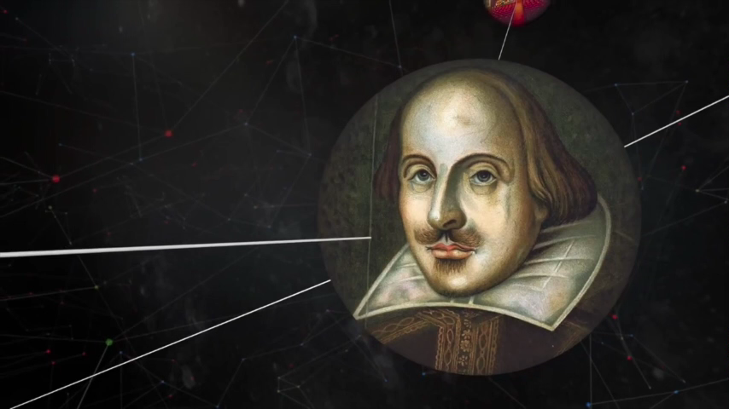
Knowledge Graph: Storing Human Knowledge
Freebase
1.9 billion triples

Slide 14
Representing Textual Data
Trainable, Learnable
[1/0,1/0,…,1/0]
[tf*idf, …,tf*dif]
[#w₁,#w₂,#w₃,….,#w_{n}]
Traditional, Fixed Representation
New Feature Representation
High-dimensional, sparse
Heavy domain expertise
Expensive engineering
Low-dimensional, dense
Data and model driven
Task oriented

Slide 15
Traditional Representation
Vocabulary: I Like NLP Deep Learning We Love Neural Network
Document
#1
I like NLP
1
1
1
0
0
0
0
0
0
I like Deep Learning
Document
#2
1
1
0
1
1
0
0
0
0
Document
#3
We love neural network
0
0
0
0
0
1
1
1
1
Similarity(DOC#2, DOC#3)???

Slide 16
Traditional Representation
Vocabulary: I Like NLP Deep Learning We Love Neural Network
Document
#1
I like NLP
TF=1
DF=2
TF=1
DF=2
TF=1
DF=1
I like Deep Learning
Document
#2
TF=1
DF=2
TF=1
DF=2
TF=1
DF=1
TF=1
DF=1
Document
#3
We love neural network
TF=1
DF=1
TF=1
DF=1
TF=1
DF=1
TF=1
DF=1
TF(w,d): count of word w in document d
DF(w): #docs containing w
Similarity(DOC#2, DOC#3)???

Slide 17
New Representation with Deep Learning
100~300 dimensions
1
0
1
0
I am happy to be here
I am happy to be here
5000~10000 words
1
0
1
1

Slide 18
Roadmap of this Lecture
Representing
Words
Representing
Phrases/Sentences
Representing
Documents
Neural language model
Word2vect
GloVe
Recursive Neural Network
Recurrent Neural Network
Convolutional Neural Network
Convolutional Neural Network

Slide 19
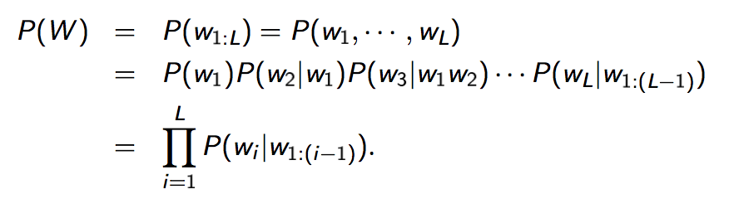
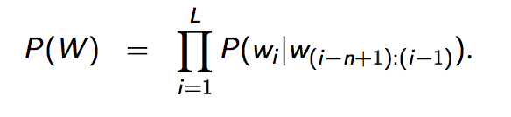
Statistical Language Models
A statistical language model is a probability distribution over sequences of words. A sequence W consists of L words (eg: I like deep learning):
N-gram language model

Slide 20
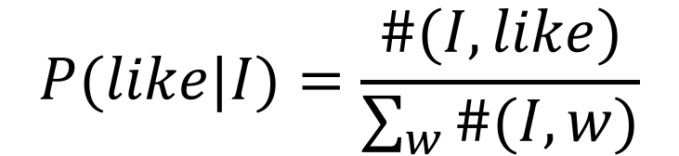
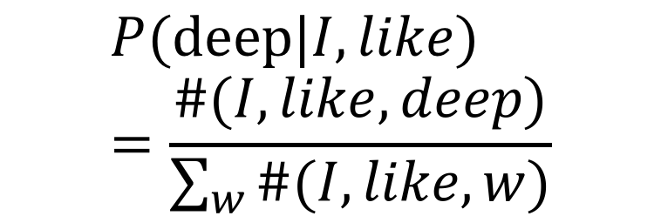
Statistical Language Models
P(I like deep learning) =P(I)* P(like|I)* P(deep|I like)* P(learning|I like deep)
For 1-gram LM (unigram LM):
P(I like deep learning) =P(I)* P(like)* P(deep)* P(learning)
For 2-gram LM (bigram LM):
P(I like deep learning) =P(I)* P(like|I)* P(deep|like)* P(learning|deep)
$$P(like|I)=\frac{\#(I,like)}{\sum_{w}{\#(I,w)}}$$
$$P(deep|I,like)=\frac{\#(I,like,deep)}{\sum_{w}{\#(I,like, w)}}$$
Word order matters

Slide 21
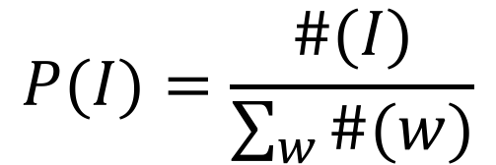
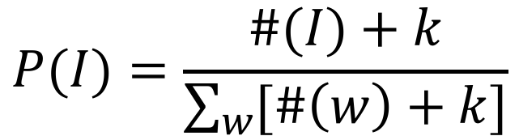
Issues with Traditional Language Models
Data sparsity: n cannot be too large
Model size grows exponentially with the size of vocabulary:
Trigram: Model size = |V|³
Reliable probability estimation: smoothing techniques
$$P(I)=\frac{\#(I)}{\sum_{w}{\#(w)}}$$
$$P(I)=\frac{\#(I)+k}{\sum_{w}{[\#\left(w\right)+k]}}$$

Slide 22
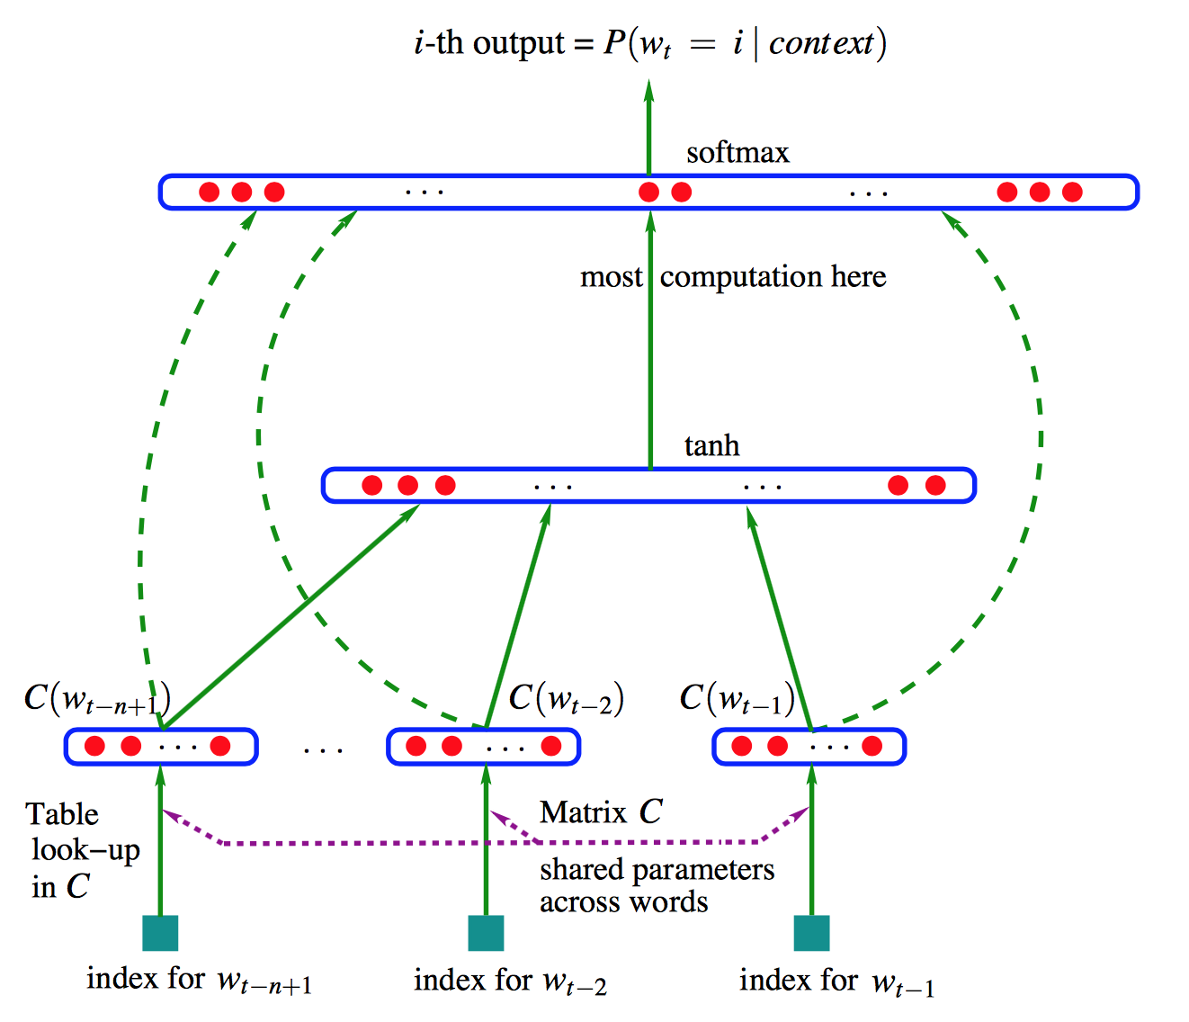
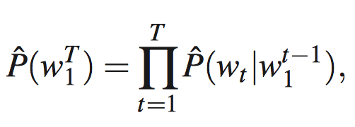
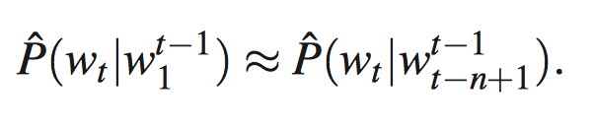
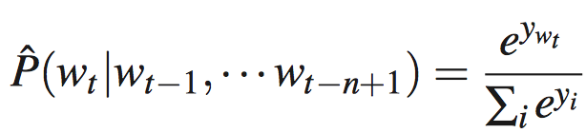
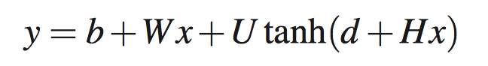
Neural Probabilistic Language Model
Evolve from traditional language models
Bengio et al 2003. A Neural Probabilistic Language Model. JMLR 3 (2003) 1137–1155

Slide 23
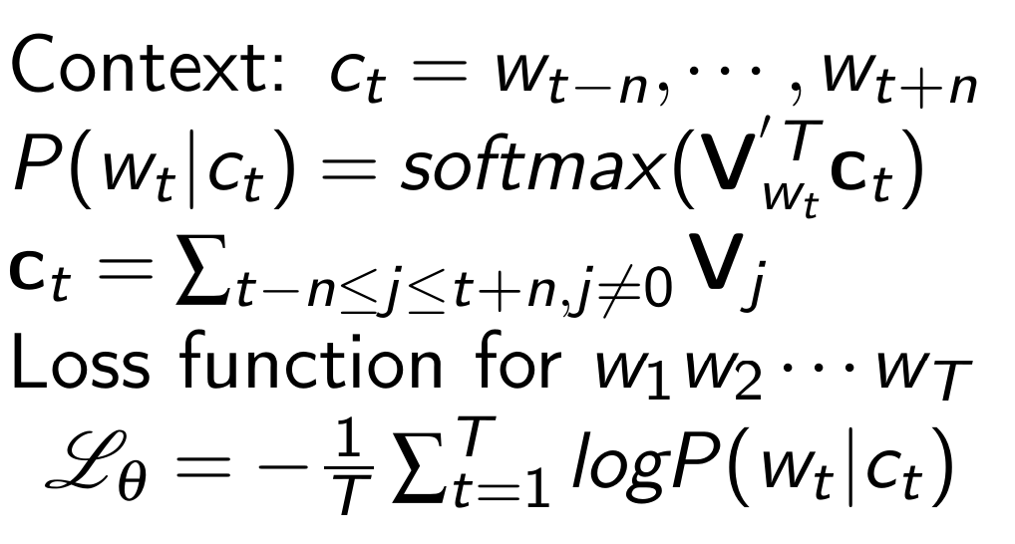
Representing Words
CBOW: Continuous Bag-Of-Words
Predicting the current word from contextual words
W_{t-2}
W_{t-1}
W_{t+1}
W_{t+2}
SUM
W_{t}
Each word has an input vector V and output vector V‘
Mikolov et al 2013. Efficient Estimation of Word Representations in Vector Space

Slide 24
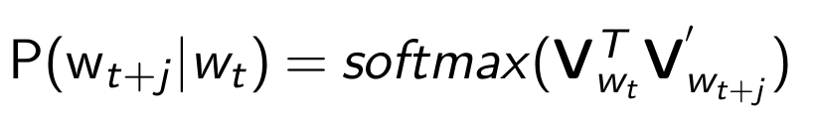
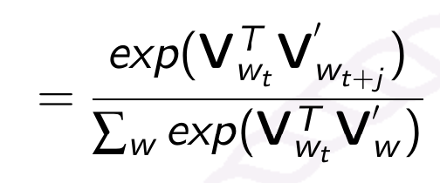
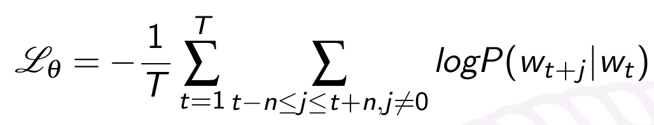
Representing Words
Skip-gram: predicting the contextual words from the current word
W_{t-2}
W_{t-1}
W_{t+1}
W_{t+2}
PROJECTION
W_{t}
NO hidden layer
Each word has an input vector V and output vector V‘
Mikolov et al 2013. Efficient Estimation of Word Representations in Vector Space

Slide 25
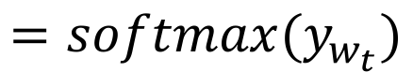
What If Very Large Vocabulary
The normalization factor is too expensive for computation
Solution
Hierarchical Softmax: a tree-structured vocabulary
Negative Sampling: sample some random words for the context
$${=softmax(y}_{w_{t}})$$
Mnih and G. Hinton. A scalable hierarchical distributed language model . In: Advances in neural information processing systems (2009).
F. Morin and Y. Bengio. Hierarchical Probabilistic Neural Network Language Model. In: Aistats. Vol. 5. Citeseer. 2005, pp. 246 252.
T. Mikolov et al. Efficient estimation of word representations in vector space . In: arXiv preprint arXiv:1301.3781 (2013).

Slide 26
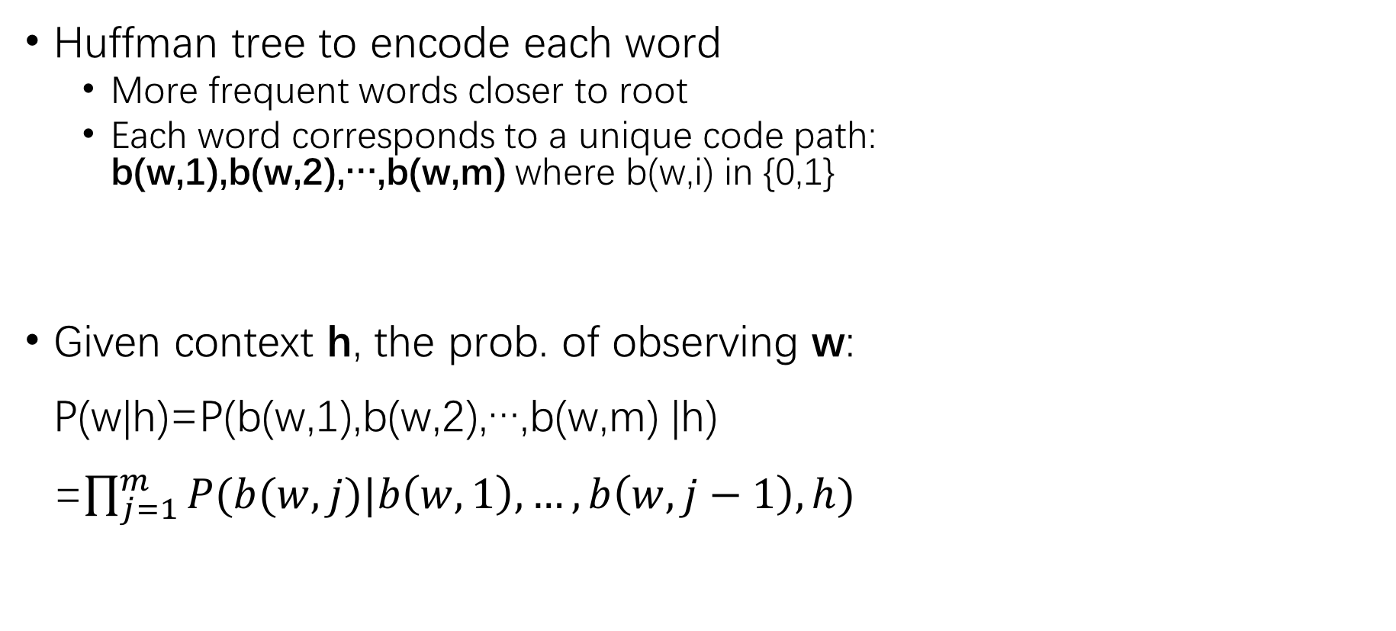
Hierarchical Softmax
0
1
Huffman tree to encode each word
More frequent words closer to root
Each word corresponds to a unique code path: b(w,1),b(w,2),…,b(w,m) where b(w,i) in {0,1}
Given context h, the prob. of observing w: P(w|h)=P(b(w,1),b(w,2),…,b(w,m) |h) =$\prod_{j=1}^{m}{P(b(w,j)|b\left(w,1\right),…,b\left(w,j−1\right),h)}$
w₁
0
1
0
w₂
1
0
For w₃: b(w,1)=1, b(w,2)=1, b(w,3)=0
10
w₃
w₄
110
111

Slide 27
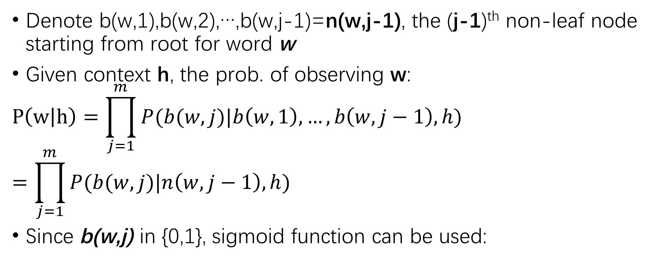
Hierarchical Softmax
Denote b(w,1),b(w,2),…,b(w,j-1)=n(w,j-1), the (j-1)^{th} non-leaf node starting from root for word w
Given context h, the prob. of observing w:
$$P\left(w | h\right)=\prod_{j=1}^{m}{P(b(w,j)|b\left(w,1\right),…,b\left(w,j−1\right),h)}$$
$$=\prod_{j=1}^{m}{P(b(w,j)|n\left(w,j−1\right),h)}$$
Since b(w,j) in {0,1}, sigmoid function can be used:
0
1
w₁
0
1
0
w₂
1
0
10
w₃
w₄
110
111
$P(b\left(w,j\right)=1|n\left(w,j−1\right),h)$=$sigmoid(W_{n\left(w,j−1\right)}h+b_{n(w,j−1)})$

Slide 28
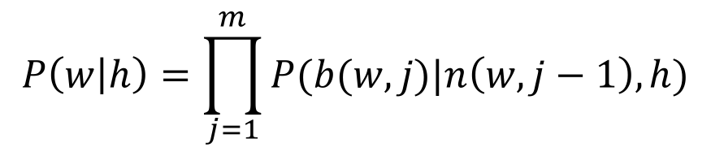
Computation Reduction in Hierarchical Softmax
For each word w, at most log|V| nodes needs to compute
Each word has at most log|V| path codes (n(w,i) is prefix)
log|V| is the height of Huffman tree
More frequent words have short paths – More accelerations!
Speed up from |V| to log|V|
$$P\left(w | h\right)=\prod_{j=1}^{m}{P(b(w,j)|n\left(w,j−1\right),h)}$$

Slide 29
Computation Reduction in Hierarchical Softmax
Each word is associated with more parameters
The number of nodes in the code path
At most log|V| nodes
Total #parameters of the model= |V|*log|V|
Better time efficiency at the cost of space!
$P(b\left(w,j\right)=1|n\left(w,j−1\right),h)$=$sigmoid(W_{n\left(w,j−1\right)}h+b_{n(w,j−1)})$

Slide 30
Accelerating the Training Process
Negative Sampling
Observed, true samples
Generated, fake samples
I like deep learning
Skip-gram
P(like|I,Deep)
I hate deep learning
I love deep learning
I play deep learning
I code with deep learning
Mnih and G. Hinton. A scalable hierarchical distributed language model . In: Advances in neural information processing systems (2009).
F. Morin and Y. Bengio. Hierarchical Probabilistic Neural Network Language Model. In: Aistats. Vol. 5. Citeseer. 2005, pp. 246 252.

Slide 31
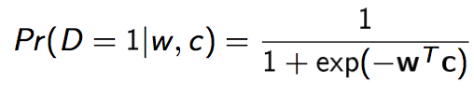
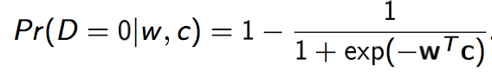
Skip-gram Model
Given a pair of <word, context> (w,c), the probability that word w is observed in the context c is given by:
where w and c are embedding vectors of w and c respectively. The probability of not observing word w in the context c is given by:

Slide 32
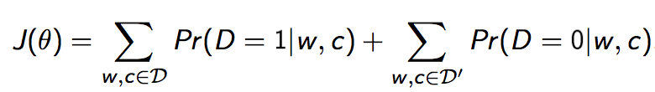
Skip-gram Model
Given a training set D, the word embeddings are learned by maximizing the following objective function:
where the set D′ is randomly sampled negative examples, assuming they are all incorrect.

Slide 33
Computation Reduction in Negative Sampling
From the normalization factor to a sigmoid function

Slide 34
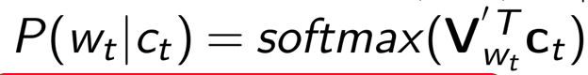
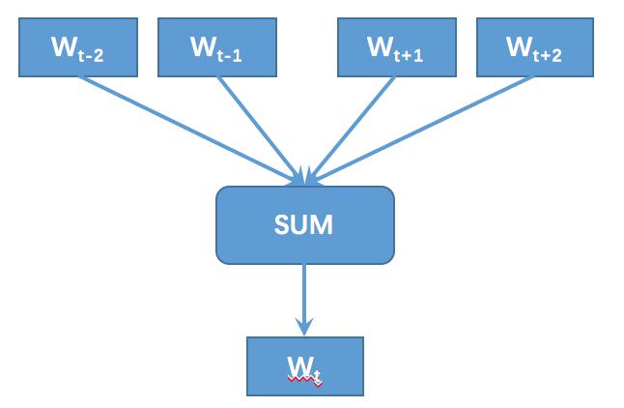
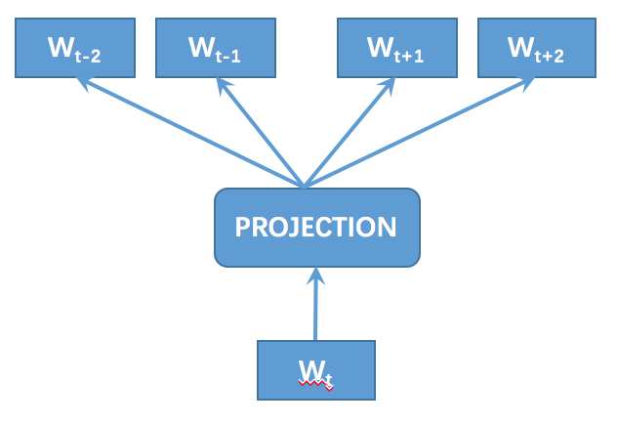
CBOW
Skip-gram
Train the model
A very large corpus:
Many many documents
Word vectors are the parameters of the model

Slide 35
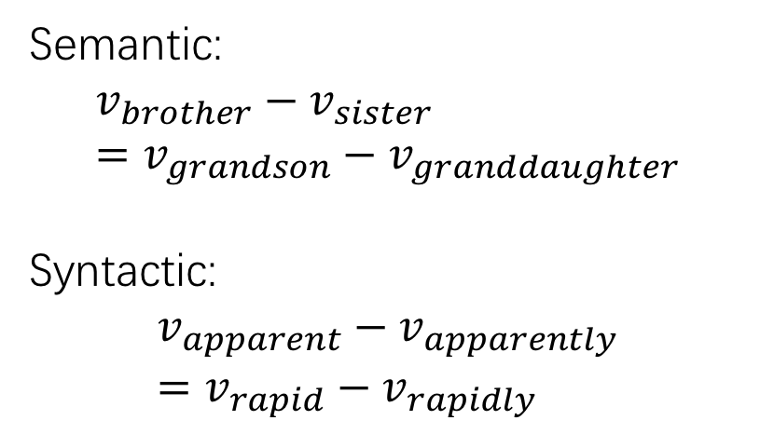
Language Regularity
Words similar to“Sweden”
word | Cosine similarity
norway | .760
denmark | .715
finland | .620
switzerland | .588
belgium | .585
netherlands | .575
Semantic:
$$v_{brother}−v_{sister}=v_{grandson}−v_{granddaughter}$$
Syntactic:
$$v_{apparent}−v_{apparently}=v_{rapid}−v_{rapidly}$$
http://deeplearning4j.org/word2vec

Slide 36
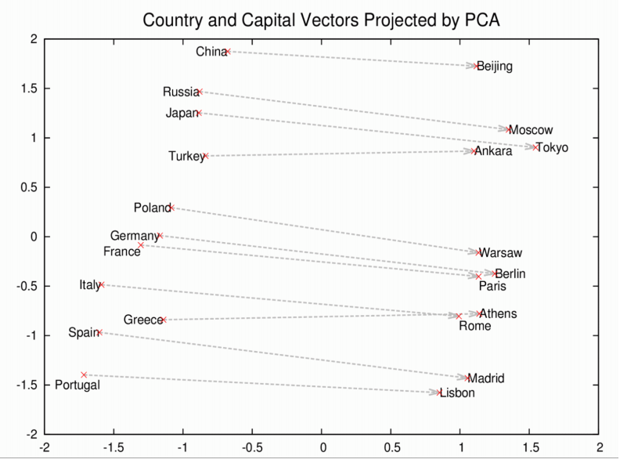
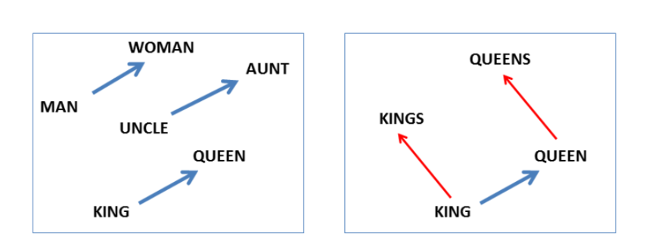
Language Regularity
http://deeplearning4j.org/word2vec

Slide 37
Now, each word can be represented by
A low-dimensional, real-valued, and dense vectors
0.123
0.978
-0.360
0.243
0.673
-0.445
0.789
-0.123
0.809
Deep=
-0.150
Learning=
-0.450
NLP=
-0.961
0.893
0.708
0.537
0.163
0.467
0.189
-0.876
-0.234
-0.776

Slide 38
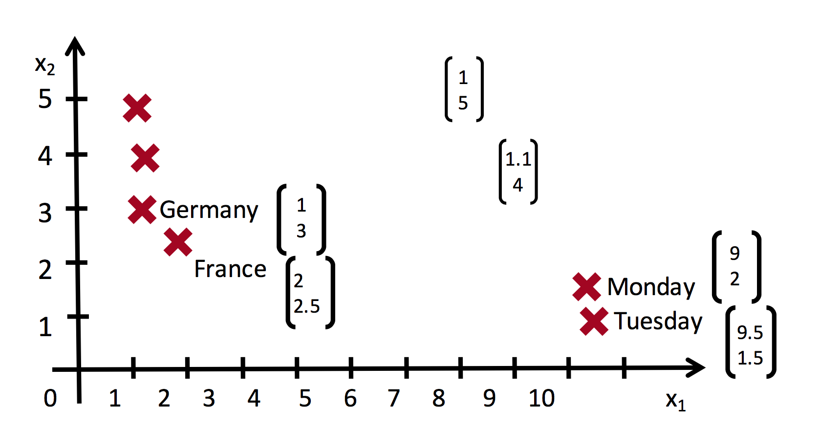
Word Vectors
Words similar in semantics are close in vector space
Slides from Socher CS224d

Slide 39
Resources for Word Vectors
download
glove
homepage: https://nlp.stanford.edu/projects/glove/
code: https://github.com/maciejkula/glove-python
word vectors: http://nlp.stanford.edu/data/glove.6B.zip
word2vec
homepage: https://code.google.com/archive/p/word2vec/
code: https://github.com/tmikolov/word2vec
word vectors: https://drive.google.com/file/d/0B7XkCwpI5KDYNlNUTTlSS21pQmM/edit
Chinese corpus
https://dumps.wikimedia.org/zhwiki/latest/zhwiki-latest-pages-articles.xml.bz2

Slide 40
Word Vector Training with Word2vec
Exemplar command
./word2vec -train text8 -output vectors.bin -cbow 1 -size 200 -window 8 -negative 25 -hs 0 -sample 1e-4 -threads 20 -binary 1 -iter 15
Parameters
-train: Use text data from <file> to train the model
-output: Use <file> to save the resulting word vectors
-size: Set size of word vectors; default is 100
-window: Set max skip length between words; default is 5
-sample: Set threshold for occurrence of words.
-hs: Use Hierarchical Softmax; default is 0
-negative: Number of negative examples; default is 5
-threads: Use <int> threads (default 12)
-iter: Run more training iterations (default 5)
-binary: Save the resulting vectors in binary moded; default is 0 (off)

Slide 41
Messages about Word Vectors
Representing word with vector is a precursor for natural language understanding with deep learning
Well pre-trained word vectors are crucial for the performance
Fine-tuning word vectors generally improve the performance but a well pre-trained word vectors are good enough, and sometimes even degrade the performance.

Slide 42
Roadmap of this Lecture
Representing
Words
Representing
Phrases/Sentences
Representing
Documents
Word2vect
GloVe
Recursive Neural Network
Recurrent Neural Network
Convolutional Neural Network
Convolutional Neural Network

Slide 43
Recursive Network for NLP

Slide 44
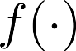
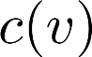
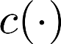
Auto-encoder
Encode the input v into some representation c(v) so that the input can be reconstructed from that representation
Encoding function c(v)
Decoding function f(c(v))

Slide 45
Encoding and decoding functions
Nonlinear function
If c and f are binary, then the functions can be used as probabilities

Slide 46
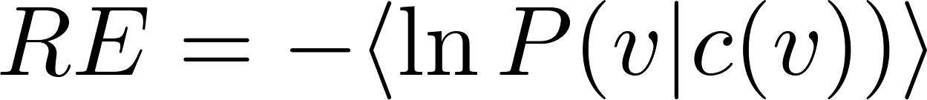
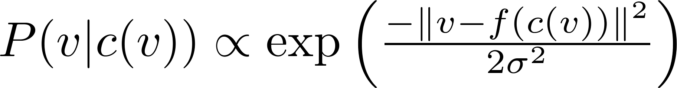
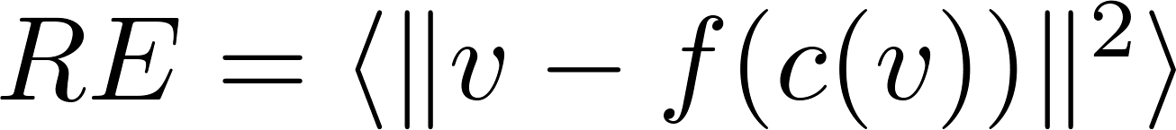
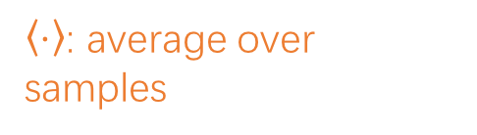
Loss function
Minimize the reconstruction error or the negative data log-likelihood
Gaussian probability (v is real)
then
Binomial probability (v is binary)
then
$〈⋅〉$: average over samples

Slide 47
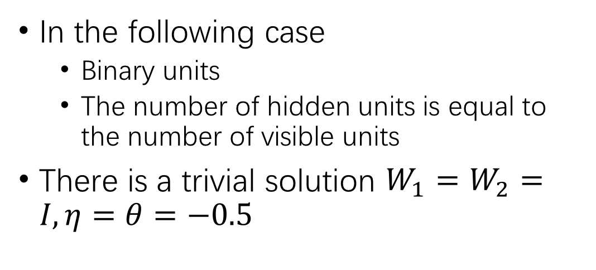
A trivial solution
In the following case
Binary units
The number of hidden units is equal to the number of visible units
There is a trivial solution $W_{1}=W_{2}=I, η=θ=−0.5$
1
1
0
0
0 | -0.5 | 0 | -0.5 | 0
1 | 0.5 | 1 | 0.5 | 1
0
0
1
1

Slide 48
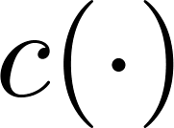
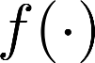
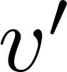
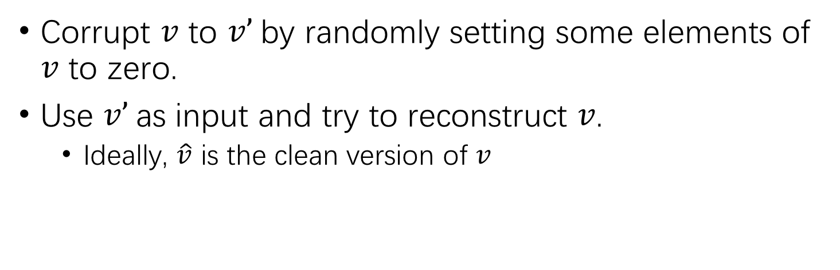
Denoising auto-encoder
Corrupt $v$ to $v’$by randomly setting some elements of $v$ to zero.
Use $v’$as input and try to reconstruct $v$.
Ideally, $\hat{v}$ is the clean version of $v$
Vincent, et al., ICML, 2008
Notes:
这个做法有点像在输入层加dropout，区别在于，这里最小化目标函数时不考虑输入中的这些noise (即0)

Slide 49
Deep Auto-encoder
Stack auto-encoders on top of each other
Train layers one by one
Fine tune with BP
Sparsity or other regularizations can be used

Slide 50
Recursive Autoencoders
Sentences/phrases have composition structures!
sentence
phrase
phrase
word

Slide 51
Recursive Autoencoders
is very interesting
Rules of Compositionality
The meaning (vector) of a sentence is determined by (1) The meanings of its words
(2) The rules that combine them
0.5
0.4
0.5
0.6
0.6
0.4
very interesting
0.4
0.5
0.6
0.7
0.4
0.3
0.6
0.5
0.4
is
very
interesting

Slide 52
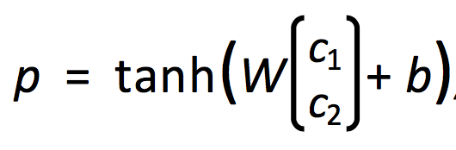

Recursive Autoencoders
0.6
0.6
0.4
V_{p}:
parent vector
Output Signal
$\hat{p}$=softmax(U^{T}*V_{p})
Composition
Function
Vp
Same W parameters at all nodes of the tree
0.7
0.4
0.3
0.6
0.5
0.4
c₁
c₂

Slide 53

Recursive Autoencoders
Train the model
No supervision: minimizing reconstruction error
V_{p}:
parent vector
0.6
0.6
0.4
Output Signal
Composition
Function
0.7
0.4
0.3
0.6
0.5
0.4
0.6
0.6
0.4
V_{p}
c'₁
c'₂
0.7
0.4
0.3
0.6
0.5
0.4
0.7
0.4
0.3
0.6
0.5
0.4
c₁
c₂
c₁
c₂

Slide 54


Recursive Autoencoders
0.6
0.6
0.4
Train the model
With supervision: minimizing cross entropy error
V_{p}: parent vector
Output Signal
Composition
Function
The gold distribution over class labels k
0.7
0.4
0.3
0.6
0.5
0.4
The predicted distribution based on the parent vector V_{p}
c₁
c₂
$\hat{p}$=softmax(U^{T}*V_{p})

Slide 55

Recursive Autoencoder
Given the tree structure, we can compute all the node vectors from bottom to top.
Train by minimizing reconstruction error
Socher et al. Semi-Supervised Recursive Autoencoders for Predicting Sentiment Distributions

Slide 56




Semi-Supervised Recursive Autoencoders
The task label can be introduced in all nodes of the tree.
Socher et al. Semi-Supervised Recursive Autoencoders for Predicting Sentiment Distributions

Slide 57
Comments on Recursive Autoencoders
Dependent on a tree structure
Parser is required
Deep structures (h=logN)
More supervision is required (at the internal nodes)

Slide 58
Recurrent Network for NLP

Slide 59
Recurrent Neural Network
Standard recurrent neural network
Gated recurrent network（GRU）
Long Short-term Memory

Slide 60

Issues with MLPs?
Problem 1: Can not model sequences
Fixed-sized Inputs & Outputs
No temporal structure, thus no dynamics
Problem 2: Pure feed-forward processing
No “memory”, no feedback

Slide 61






Dynamic systems

Slide 62


Sequences are everywhere…

Slide 63


Even where you might not expect a sequence…

Slide 64
Why model sequences?

Slide 65
Recurrent Neural Network
Please go to another slide for this part

Slide 66
Comments on Recurrent Models
Become a standard choice of sentence-level representation
Very suitable for long-context modeling
Attention is usually applied
Context Vanishing
The beginning context is vanishing with very long texts

Slide 67
Convolutional Network for NLP

Slide 68

Convolutional Network for NLP
Final representation
Yoon Kim. 2014. Convolutional Neural Networks for Sentence Classification. In EMNLP. Association for Computational Linguistics, 1746–1751.

Slide 69




Convolution Layer
Word vectors:
Sentence (concatenating words sequentially):
Words in range (a vector):
Convolutional filter (a vector), h is a window of h words:

Slide 70



Convolution Layer
The feature value of position i:
All possible windows:
The resulting feature map:

Slide 71
Convolution Layer
When the window width h=2
c₁
c₂
c₃
c₄
4=5-2+1
1.2
2.1
1.4
0.9
0.4
0.2
0.6
0.4
0.5
0.3
0.4
0.5
0.6
0.7
0.4
0.3
0.8
0.7
0.1
The
movie
is
very
interesting

Slide 72

Pooling Layer
Feature map with W:
Pooling this vector to a single scalar (max, min, mean):
But only ONE value here? Machine learning generally requires more input values

Slide 73

Final Softmax Layer
Using multiple filters W (~100), and multiple window h
The final vector is of N_w*N_h
The final feature vector
Z=[c_{h_1,1},c_{h_1,2},…,c_{h_1,N_w},c_{h_2,1},c_{h_2,2},…,c_{h_2,N_w}… ]
h_i: how many types of windows
N_w: how many filters
The final softmax layer (or another MLP layer) takes z as input:

Slide 74

Advanced CNN Models for NLP
One-dimensional convolution
K-max pooling over time
Multiple filters and multiple channels
Very similar to image processing
N. Kalchbrenner, E. Grefenstette, and P. Blunsom. A Convolutional Neural Network for Modelling Sentences . In: Proceedings of ACL. 2014.

Slide 75


Advanced CNN Models for NLP
Convolutional Neural Network
Lei T, Barzilay R, Jaakkola T. Molding cnns for text: non-linear, non-consecutive convolutions[J]. EMNLP, 2015.

Slide 76
Comments on CNN for NLP
Suitable for longer text
Deep structures (multiple con/pool operations) seem to be NOT that helpful
Not as strong as other models such as recursive/recurrent models

Slide 77
Summary
Word representation
Word vectors
Phrase/sentence representation
Recursive models
Recurrent models
CNN
Document representation
CNN
Hierarchical models (RNN)
Hybrid models

Slide 78


Summary
0.123
0.243
0.789
-0.150
0.893
0.163
-0.876
Deep

Slide 79
Advance Topics of Deep Learning for NLP
Memory network
Deep reinforcement learning
Sequence2Sequence learning

Slide 80

Memory Network Models
Neural Differentiable Computer

Slide 81

Deep Reinforcement Learning
Deep learning to represent states, actions, or policy functions

Slide 82

Sequence to Sequence Learning
From Sequence X₁ X₂ …X_{m} to Y₁ Y₂…Y_{n}
Machine translation, dialogue generation

Slide 83
Thanks for Attention
Dr. Minlie Huang
aihuang@tsinghua.edu.cn
Homepage: http://aihuang.org/p

